Slide 1
Key Dates Paper two American West

Slide 2
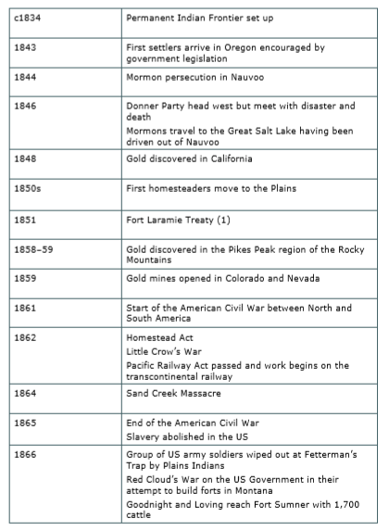
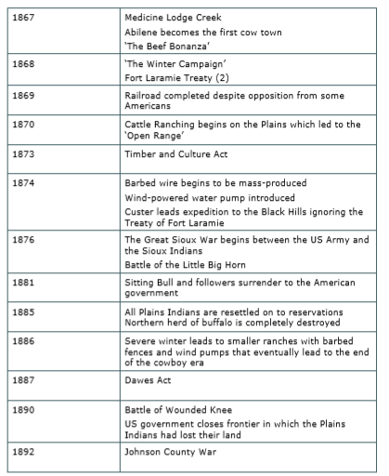
Some key dates

Slide 3
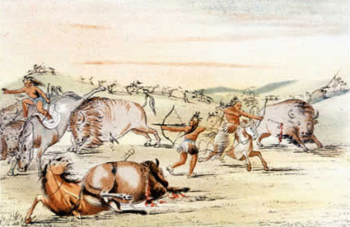
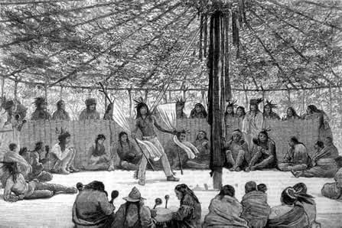
American West
Structure: Law Enforcements
.US Marshals
.Deputy Marshals
.Town Marshals
.Sheriffs
1883—Destruction of the Northern Buffalo Herd completed
1885—All Native Americans confined to reservations
1875—Destruction of the Southern Buffalo Herd
1868—Fort Laramie Treaty
1879—Exoduster Movement
1890—Wounded Knee Massacre
1876—Battle of Little Big Horn
1893—Oklahoma Land Rush
1846—Mormon Migration
1851—Fort Laramie Treaty
1864– Sand Creek Massacre
1873—Timber Culture Act
1886– 87—Harsh Winter
1861—American Civil War
1836 – Oregon Trail opens
1862—Little Crow’s War
1835 | 1840 | 1850 | 1860 | 1870 | 1880 | 1890 | 1895
1849– California Gold Rush
1887—Dawes Act
- Conflict
1875—Black Hill Gold Rush
1890—Frontier Closed
1851—Indian Appropriations Act
1866— Red Clouds War
1881- Gunfight at OK Coral
1892—Johnson County War
1862—Pacific Railroad Act
1846– Oregon Treaty agreed with Britain
1862— Homestead Act Passed
- Settlement
1868—Transcontinental Railroad complete
- Native Americans
1874— Joseph Glidden invented barbed wire
Structure: Tribe
.Bands
.Chiefs
.Tribes
.Warrior Societies

Slide 4
Key Academic Language Paper Two- American West

Slide 5
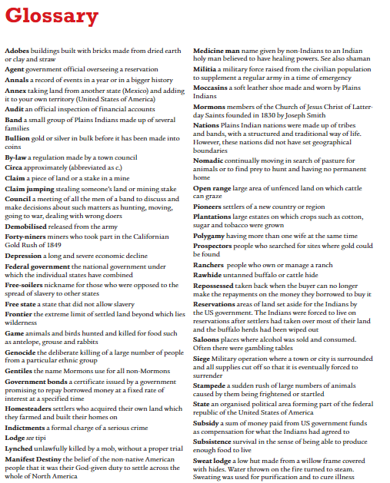

Slide 6
Key Dates Paper two Elizabeth

Slide 7
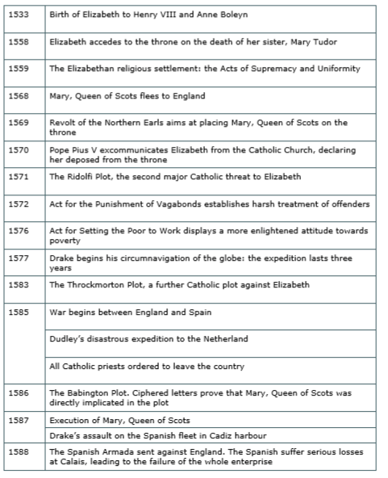
Some key dates

Slide 8
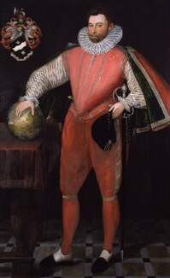
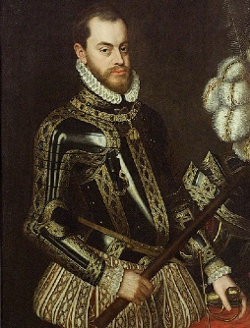
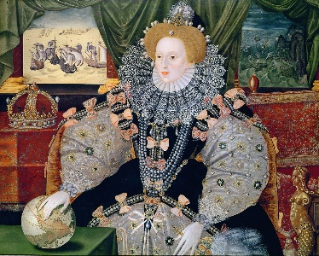
Elizabeth
1562—Elizabeth ill with smallpox -> was asked to marry/ name her successor
1572—Elizabeth sent secret aid to Protestants in Netherlands rebelling against Spanish
1559— Religious Settlement -> established Protestant Church and established herself as Supreme Governor
1570—Pope Pius IV excommunicated Elizabeth for naming herself Supreme Governor
1585—Parliament passed tougher laws against Catholic priests
1569—Catholic rebellion to make Mary Queen of Scots Queen
1568– John Hawkins ship attacked by Spanish in the West Indies
1583—Throckmorton plot failed -> started Catholic uprising
1580—Jesuits spread Catholic religion in England
1558—Elizabeth Crowned Queen of England
1577—Sir Francis Drake circum navigation
1587—Execution of Mary Queen of Scots
1586—Babington Plot
1588—Spanish Armada
1558 | 1568 | 1578 | 1588
1570—Severe Poverty
1572—Vagabonds Act
1573– 77—Bad Harvest
1576— Act for relief of poor
1571— Rodolfi Plot -> Duke of Norfolk executed
1588—Elizabeth over 50, still had no successor
1568—Elizabeth imprisoned Mary Queen of Scots
1587—Sir Francis Drake destroyed 24 Spanish ships set for England
Key Figures:
Queen Elizabeth I Sir Francis Drake
King Henry VIII Sir Walter Raleigh
Anne Boleyn Pope Pius IV
Mary I Anthony Babington
Mary Queen of Scots Francis and Thomas Throckmorton
Phillip II Roberto Ridolfi
1585—Walter Raleigh set up colony of settlers in Virginia -> supported attacks on Spanish Empire

Slide 9
Key Academic Language Paper Two- Elizabeth

Slide 10
