Slide 1
Key Dates Paper three

Slide 2
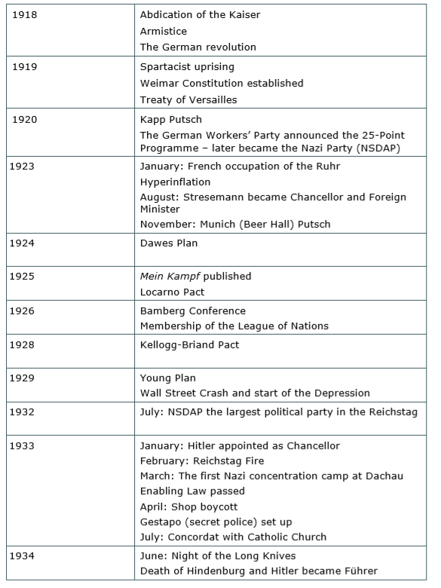
Some key dates

Slide 3
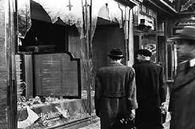
Key Figures: Weimar
Adolf Hitler
Paul von Hindenburg
Heinrich Brüning
General Franz von Papen
Kurt von Schleicher
Key Figures: Nazi Germany
Adolf Hitler
Heinrich Himmler
Marinus van Derlubbe
Joseph Goebbels
Herman Georing
Key Topic 1: Weimar Republic, 1918-29
Key Topic 2: Hitler’s Rise to Power, 1919-33
1925—Mein Kampf Published
1920—Kapp Putsch
1933—Concordat with Catholic Church
1918— Kaiser Wilhelhm Abdicates
1924—The Dawes Plan
1933—Enabling law passed -> gave Hitler power to enact laws without the Reichstag
1919—Spartacist uprising
1934—Night of the Long Knives
1938—Kristallnacht
1919—Treaty of Versailles
1923—Munich Putsch
1929—The Young Plan
1935—Nuremberg Laws
1928—Kellog- Briand Pact
1923—Hyperinflation
1926—Bamberg Conference
1933—Reichstag Fire
1936—Berlin Olympics
1925—Locarno Pact
1918 | 1920 | 1925 | 1930 | 1935 | 1938
1918—Armistice Signed
1919—Weimar Constitution established
1933—Gestapo established
1933—Hitler becomes Chancellor
1933 - Boycott of Jewish businesses
Edelweiss Pirates
1923—French occupation of the Ruhr
1933—Reich Church founded
KT 3&4: Life and Nazi Control in Germany, 1933-39
1923— Gustav Stresemann made chancellor
1932— Nationalist Socialist German Worker’s Party largest party in the Reichstag
1934—Death of Hindenburg -> Hitler becomes Führer
1926—Germany joined the League of Nations
1929—Wall Street Crash -> start of economic crisis in Germany

Slide 4
Key Academic Language Paper three

Slide 5
