Slide 1
Key Dates Paper one

Slide 2
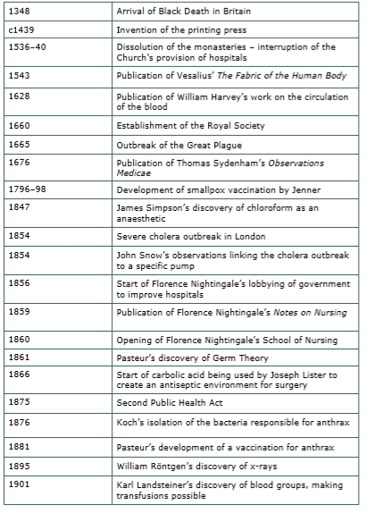
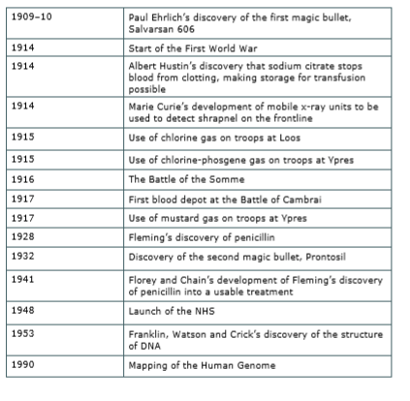
Some key dates

Slide 3
Medicine in Medieval England, 1250-1500
Reasons for Little Change in Medicine:
4 Humours:
Black Bile
Blood
Phlegm
Yellow Bile
The Church
God sent the disease, therefore there was no need to search for another explanation as well as the fear of hell if you questioned the Bible/ Church/ God’s Plan
The church supported ideas made by Galen therefore no Christian dared to question his ideas
Education
Church controlled this, including how Physicians trained at university
Followed the work of Hippocrates and Galen
Individuals
Education was limited and the under church control therefore did not encourage new ideas
Treatments:
Herbal remedies
Bleeding to re-balance the Humours
Surgery
1250
1500
Prevention - Keeping Towns Clean:
Too many animals -> Rakers were employed
Waste and Litter -> laws were passed to punish throwing waste and public latrines were often built in towns
Dirty water -> ways of bringing in fresh water to towns
Case Study: Black Death 1348-49
Broke-out in China > India > Across Europe > England
Estimated at least 40% of the population died
Every few years it would break-out again, for 300 years
England – arrived in Devon, moved up North
Medieval Healers:
Women— they knew a range of remedies
Hospitals—run by monks
Physicians—100 in 1300
Surgeons (Barber Surgeons) - perform basic surgery
Apothecaries—mixed ingredients to make medicines, ‘herbal healers’
God’s punishment, Miasma, Impact of the planets, Theory of the 4 Humours
Pray for forgiveness, Pilgrimages, Ringing bells, Lighting fires
Holy charms, Pray, Bleeding/ purging, Galen’s ‘treatment of opposites’

Slide 4
The Medical Renaissance in England, 1500- 1700
Tradition VS Change
Community Care:
Most of the ill were still cared for at home, community members helped with home remedies
Change : By 1700 very few still believed in the theory of the 4 humours
Apothecaries and Surgeons:
Better trained in guild systems
Had to have a licence to practice
William Harvey: 1700
Stressed the importance of observing and recording patients symptoms
Discovered blood circulation,
Disproved Galen’s theories that new blood is produced by the liver
Dissected live cold blooded animals – proved the body had a one way system for blood
The Printing Press:
Created in 1440, but spread throughout the 1500s
Aided the production and distribution of medical texts
Physicians:
Better access to medical texts led to better treatment
Changes in Treatment:
More emphasis on removing Miasma (e.g. through removing sewage)
Theory of transference
People regularly changed their clothes to try and keep clean
New rational explanations for the causes of disease -> contradicted religious explanations and challenged the authority of the catholic church
1500 1600 1700
Vesalius – 1533
Carried out dissections on human bodies
Discovered spermatic vessels
Improved understanding of the body and made the study of anatomy central
Disproved Galen
His book The Fabric of the Human Body was used to train doctors in England who gained more detailed and accurate knowledge of the anatomy
Thomas Sydenham - 1645:
Found that disease had nothing to do with the person who had it
Based treatments on disease as a whole
Moved away from herbal remedies and diagnosed based on science and research
Contributed to the progress of medicine by making detailed notes of illnesses
Royal Society - 1665
Carried out and recorded medical experiments
Shared scientific ideas through their journal ‘philosophical transactions’
Hospitals (continuity) :
by 1500 hospitals were treating more of the sick
Run by physicians who focussed on treating the sick rather than on religion
Continuing treatment and preventions:
Healthy Living, Herbal Remedies, Bleeding and Purging, Prayer
Case Study: The Great Plague 1665
Cause: most believed the cause to be miasma, spread by flees and rats
Treatment: transference, ‘sweat the disease out’
Prevention: large public gatherings banned, days of fasting and prayer

Slide 5
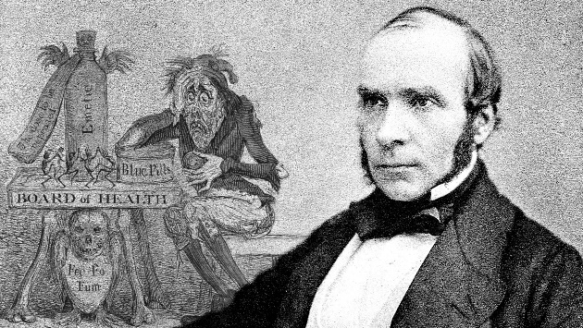
Medicine in 18th and 19th century Britain, 1700-1900
Microscopes: The development of microscopes allowed germs to be seen and studied
Case Study: Cholera 1854
Broke out in 1831, in the 1854 epidemic over 20,000 people died
Changes in hospital care:
New hospitals funded by councils and charities opened during 19th century
Hospitals cleanliness and organisation improved
Nurses given more central role
Florence Nightingale:
During the Crimean War: emphasised hygiene , fresh air, good supplies and nurses training, also published books on nursing and set up nursing school
Wrote to the British government about her recommendations
Work of John Snow:
Theorised that cholera was spread by contaminated water.
Mapped out deaths and tracked source down to one contaminated water pump
Prevented many deaths
Didn’t lead to the Public Health Act
1875 Public Health Act:
Made it compulsory for local councils to improve sewage and drainage systems. Also appointed medical officers and sanitary inspectors to inspect public health facilities
1700 1800 1900
Everyday Treatments:
Life expectancy was beginning to increase due to these medical advances, still below 50 years
Government still gave no help to the sick, the unemployed or the elderly
Home remedies continued to be produced
Vaccinations:
Edward Jenner, 1798: use of vaccination to prevent smallpox
Influences Pasteur and his vaccinations against disease
Much opposition to Jenner’s work
Anaesthetics:
James Simpson,1847: used chloroform as an effective anaesthetic during surgery
Had many negative side effects – if used too much could cause infection, led to an increase in surgical deaths
‘Patent remedies’ often known as ‘cure alls’ were sold by big businesses promising effective treatments for illness
Antiseptics:
Joseph Lister
Produced antiseptics that reduced the spread of infection and lessened the numbers of patients dying from infection
Robert Koch
Used the work of Pasteur to discover the bacteria that caused individual diseases such as typhoid or tuberculosis. Once they identified the bacteria they could then produce vaccinations
Case Study: Germ Theory
Link between dirt and disease
Proved John Snow correct
People would pay tax for public health reforms
Nightingale didn’t believe in Germ Theory – focussed on hospital hygiene

Slide 6
Medicine in Modern Britain, 1900-present
Bacteria, genetic problems, lifestyle
Vaccines, DNA screening, Lifestyle Campaigns i.e. promote dangers of smoking or of lack of exercise
Improved access to care, NHS, High-tech medical and surgical treatments in hospitals; Blood transfusions; X-rays; Heart pacemakers and Gene therapy
‘Magic Bullets’
A chemical compound that would attack and kill the microbe causing a specific disease
Known as Salvarsan 606
Cured Syphilis
1900 Present
Case Study: Penicillin—Fleming, Florey and Chain
Soldiers dying from infected wounds during WW!. Antiseptics killed but couldn’t heal infections.
Stage 1)- 1928, Fleming discovered Penicillin. Mould grew on one of his Petri dishes while he was on holiday. It killed the bacteria around it. He experimented on his colleagues eye infection by it was too severe to cure. Research halted as people didn’t see the importance of penicillin,
Stage 2)- 1938, Florey and Chain used Flemings article for research and noted the penicillin recovery in mice. However didn’t have enough funding.
1941, tested the penicillin on Albert Alexander. It failed as there wasn’t enough to clear up the infection fully.
Stage 3) - America realised the potential in penicillin and mass produced. 2.3 million doses were available ion D-Day.
Stage 4)- 1945, post war penicillin manufactured. Common use of antibiotics in 1950s and 1960s.
Case Study: Fight Against Lung Cancer
Huge rise in the number of lung cancer cases during the 20th Century
Majority of cases caused by smoking/ passive smoking, though some develop lung cancer for no apparent reason Smoking more common from 1900, especially during WWI
If suspected, most patients are given a CT scan and if this shows a mass, a sample of cells are collected and tested
Surgery to remove tumour/ lung transplant
Radiotherapy > shrink/ prevent growth
Chemotherapy > shrink/ prevent the cancer returning
High-tech medical and surgical treatments in hospitals:
Blood Transfusions
Radiotherapy and Chemotherapy
Transplant Surgery
Customised Drugs
Gene Therapy
Plastic Surgery
Dialysis Machines
Keyhole and Micro-Surgery
Improved Anaesthetics
Heart Pacemakers

Slide 7
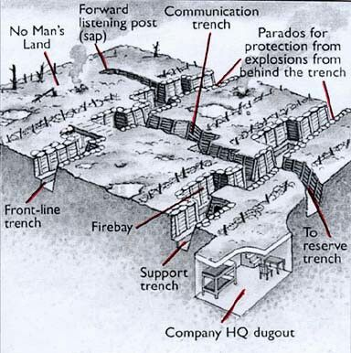
British Sector of the Western Front
Helping the wounded:
Stretcher bearers
Regimental aids
Field ambulance and dressing stations
Casualty clearing stations
Germany
Austria-Hungary
Turkey
VS
British Empire
Belgium
Russia
Serbia
France
Weapons:
rifle
Machine Gun
Artillery
Shrapnel
1915—April—May, Second Battle of Ypres
1916 - Feb—Dec, Battle of Verdun
1914—Oct—Nov, Battle of Ypres
1917—Nov—Dec, Battle of Cambrai
1915—August—Gallipoli landings
1917- July– Nov, Third battle of Ypres
1914—4th August. War begins
1917—April, U.S enters the war
1918—German Spring offensive
1914 | 1915 | 1916 | 1917 | 1918
1918– Summer—autumn, the final months
1917—April—May, Battle of Arras
1917– October– Revolution in Russia
1914—Aug—September, first trenches constructed
1916—July—Nov, Battle of Somme
Illnesses and wounded:
infection
Trench fever
Trench foot
Shell Shock
Gas
Medicine and the Western Front
treating wounds and infection :
Thomas Splint
Mobile X-Ray
Blood Transfusions and storage
Brain surgery

Slide 8
Key Academic Language Paper one

Slide 9
