Slide 1
Paper 1 (1 hour 15 minutes)
Guide to answering the questions

Slide 2
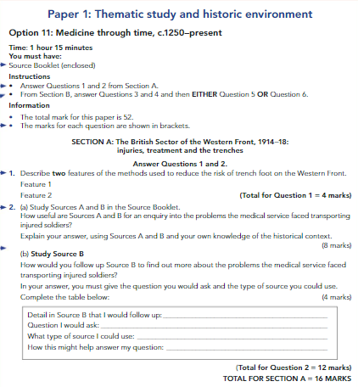

Slide 3
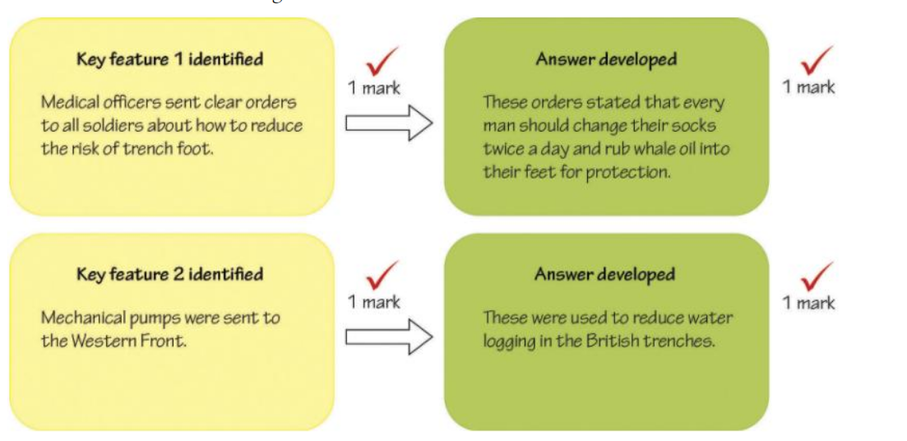
Features
What is a feature?
a distinctive attribute or aspect of something.
"a well-appointed house with interesting decorative features"
synonyms:
characteristic, attribute, quality, property, trait, mark
Describe two features of……………………..
Example question
Describe two features of the support trench system on the Western Front
(4 marks)
Where will I see this type of question?
Paper one, Section A: British Sector of the Western Front
Paper two: Section B: Early Elizabethan England

Slide 4
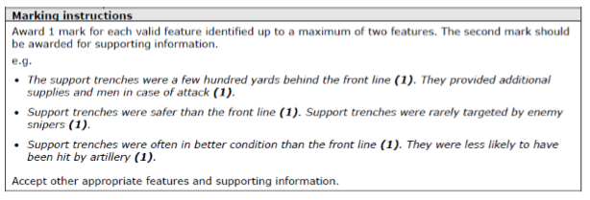
Example examiners mark scheme

Slide 5
Evaluate the usefulness of sources
What is a source?
a place, person, or thing from which something originates or can be obtained.
synonyms:
origin, cause, authority, expert, author, provenance, father, originator
How useful are sources A and B for an enquiry into…………………..
Example question
How useful are Sources A and B for an enquiry into the problems the medical service faced transporting injured soldiers? Explain your answer using sources A and B and your own knowledge of the historical context.(8 marks)
Where will I see this type of question?
Paper one, Section A: British Sector of the Western Front
Paper three: Question 3A Hitler and the Weimar Years
Remember CPNOPC (CAT)!
Content- highlight or underline useful information –judge how useful this information is in relation the question
Provenance-
Nature- What type of source is it?- how does this affect its utility (usefulness)?
Origin- Who produced it?- how does this affect its utility?
Purpose- Why was it produced- how does this affects it’s reliability?
Context- compare the key message with that of your own knowledge, do the CAT test:
Is the source comprehensive- does it have limitations?
Is the source accurate- does it match what you know about the topic?
Is the source typical- did these events happen regularly or were they unusual?
Do a CPNOPC(CAT) for both sources!

Slide 6
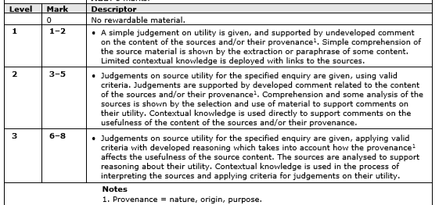
Example examiners mark scheme

Slide 7
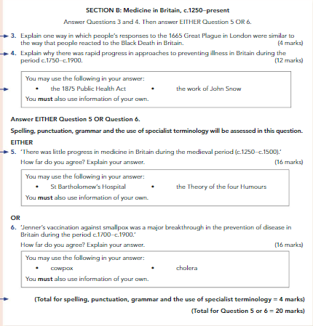

Slide 8
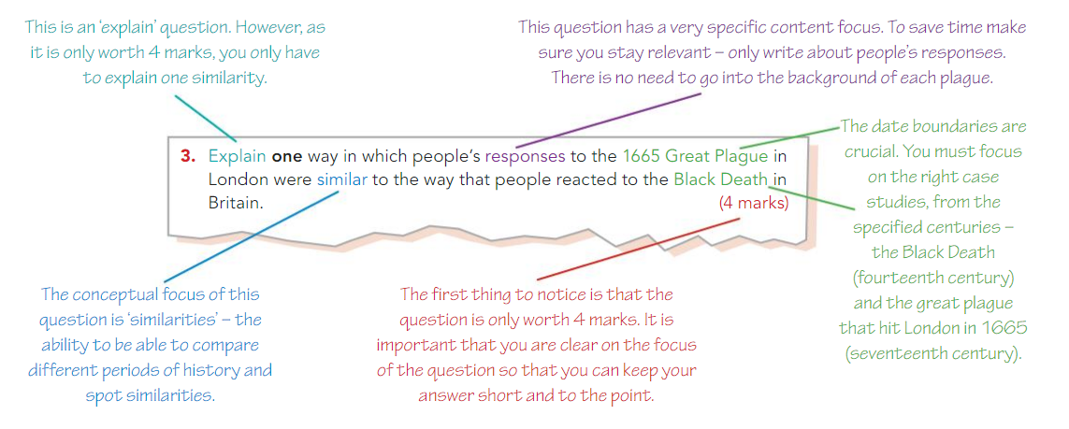
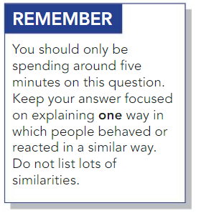
What is are similarities?
a similar feature or aspect.
"the similarities between people of different nationalities"
synonyms: resemblance, likeness, sameness, similar nature, similitude, comparability, correspondence, comparison
Compare
Describe similarities between the key features
of two different time periods……………………..
Example question
Where will I see this type of question?
Paper one, Section B: Medicine in Britain 12.50-Present

Slide 9
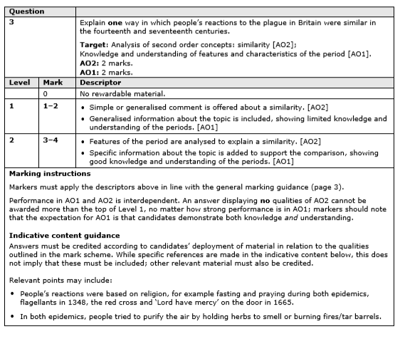
Example examiners mark scheme

Slide 10
Explain
Explain why……………………..
Example question
Explain why there was rapid progress in approaches to preventing illness in Britain during the period c.1750 –c.1900
You may use the following in your answer:
The 1875 public Health Act
The work of John Snow
You must also use information of your own.(12 marks)
What does explain mean?
To make (an idea or situation) clear to someone by describing it in more detail or revealing relevant facts.
"they explained that their lives centred on the religious rituals"
synonyms: describe, give an explanation of, make clear/plain, spell out, put into words, express in word
Where will I see this type of question?
Paper one, Section B: Medicine in Britain 12.50-Present
Paper two: Section B: Early Elizabethan England
Paper three: Weimar and Nazi Germany 1918-39

Slide 11
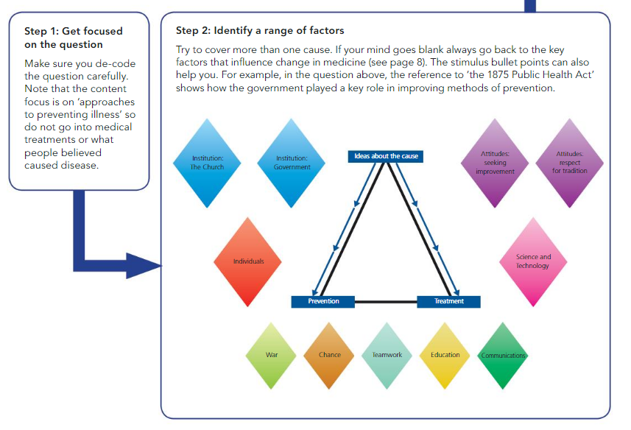
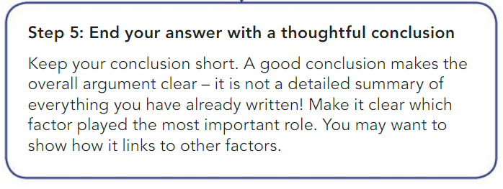

Slide 12
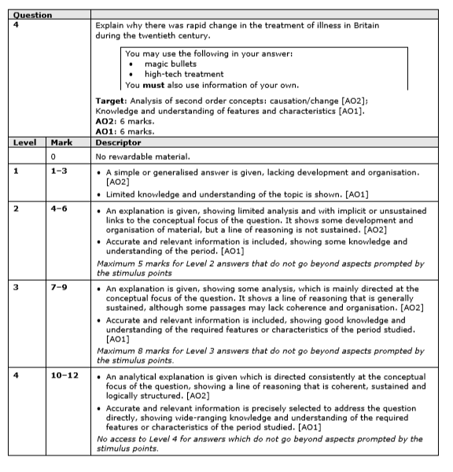
Example examiners mark scheme

Slide 13
Judgement
…Statement”….. How far do you agree? (16)
Example question
What does judgement mean?
the ability to make considered decisions or come to sensible conclusions.
"an error of judgement"
synonyms:
discernment, acumen, shrewdness, astuteness, common sense, good sense, sense, perception, perspicacity, percipience, intelligence, awareness, canniness, sharpness
“There was little progress to medicine during the medieval period *c.1250-c.1500).” How far do you agree?
You may use the following in your answer:
St Bartholomew's Hospital
The Theory of the four Humours
You must also use information of your own.(16 marks)
Don’t forget there are also 4 SPAG marks to be gained / lost here to take extra care!
Where will I see this type of question?
Paper one, Section B: Medicine in Britain 12.50-Present
Paper two: Section B: Early Elizabethan England

Slide 14
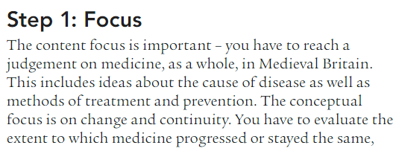
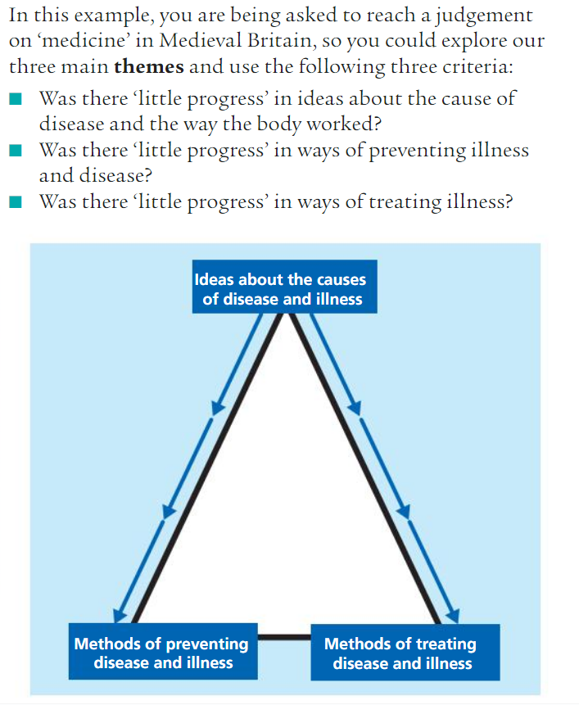
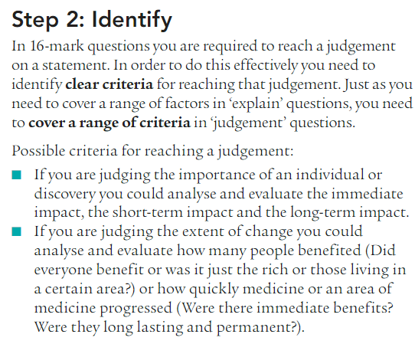

Slide 15
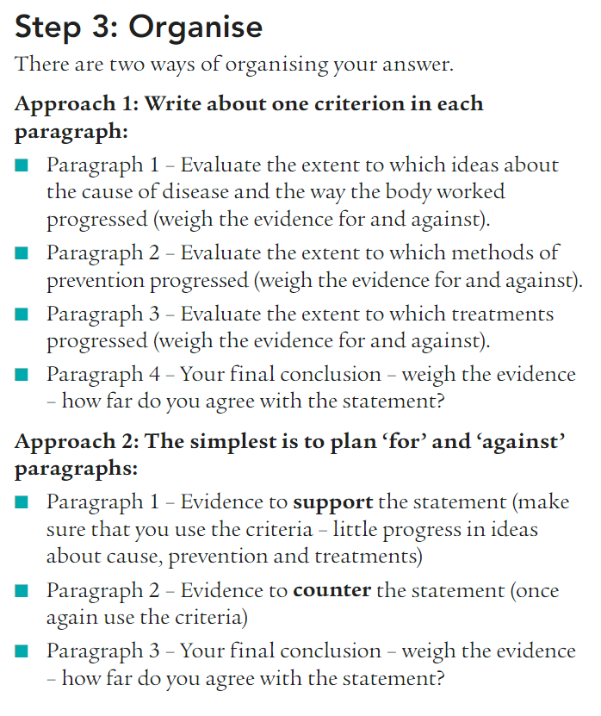
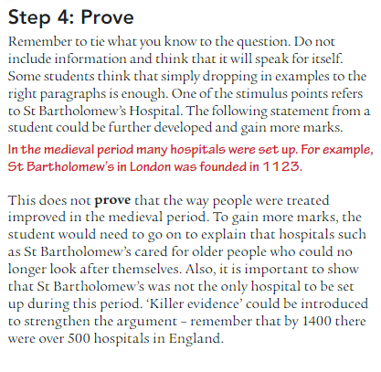

Slide 16
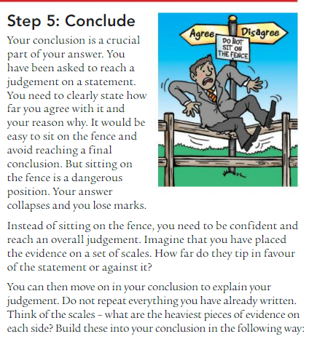

Slide 17
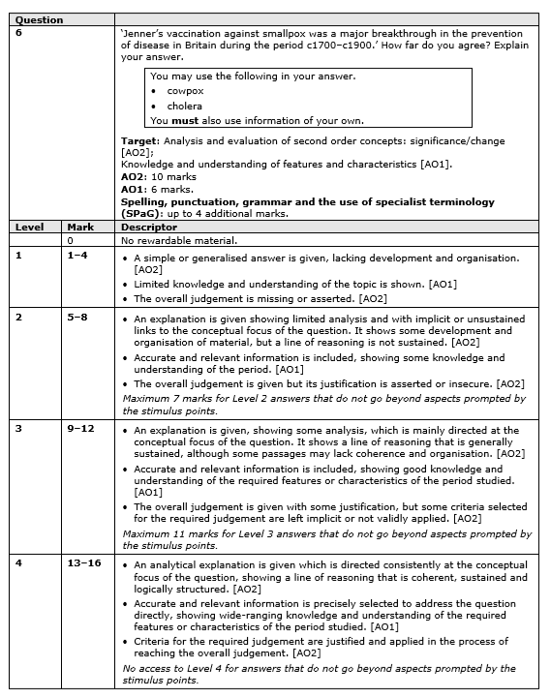
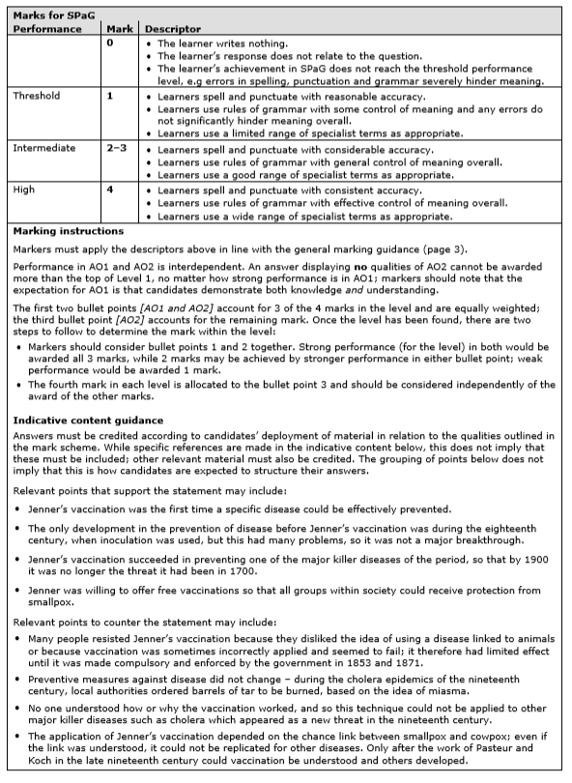
Example examiners mark scheme

Slide 18
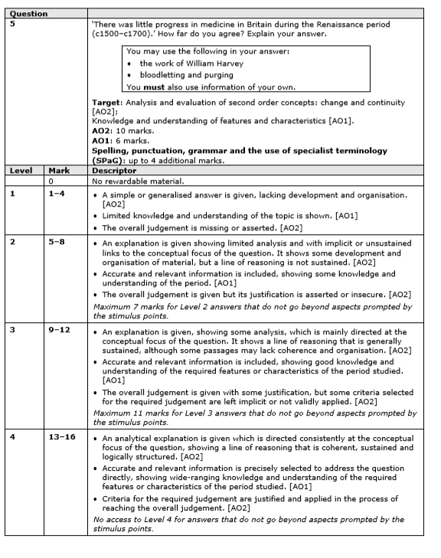
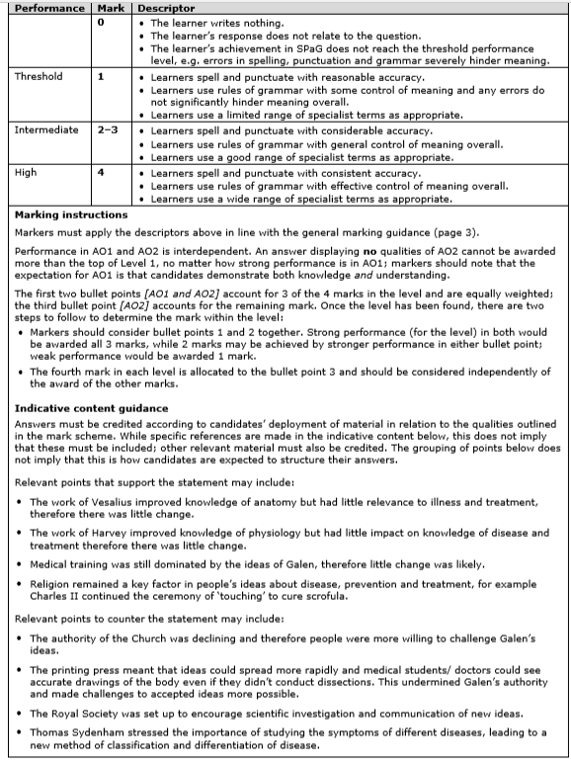
Example examiners mark scheme

Slide 19
Language aids

Slide 20
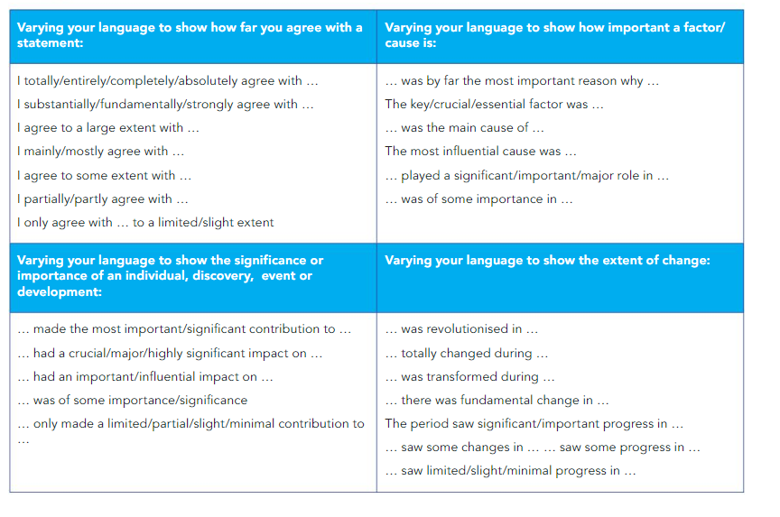

Slide 22
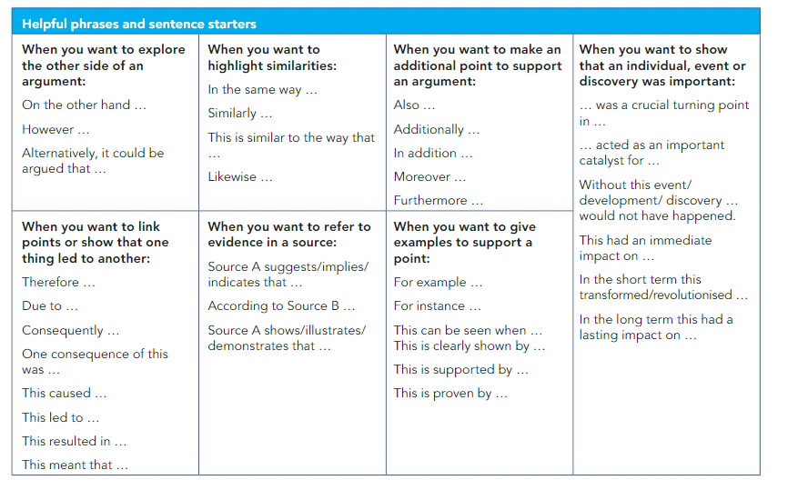

Slide 23
