Slide 1
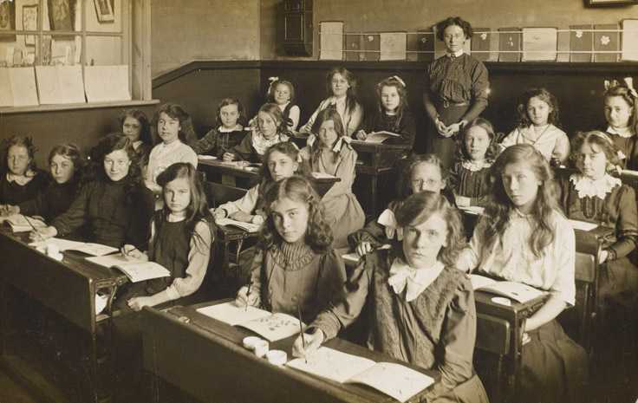
Year 8 Homework Menu
Term 5 & 6 topic: Slavery
Each week choose a task and note in your planner what course you are trying and which task you will complete. There are 8 weeks this term, so 2 x mains, 2x starters and 2 x dessert would do it!
Starter – 1 week
Write a definition on what slavery is.
Do we have modern day slavery? Explain
What was the slave resistance?
Why Olaudah Equiano important?
Main Course – 2 weeks
Write as diary extract on what it was like on the middle passage.
Research and write down what jobs slaves did.
Draw a poster to advertise a slave auction.
Write a short story about working on a cotton plantation.
Dessert – 1 week
Draw the ‘slave triangle’.
How do you think a ‘slave’ felt when being auctioned?
Who was Olaudah Equiano?
Write a definition for the word abolition.
Who were the key people involved in the abolition of slavery?

